Slide 1
Chapter 1: Introduction to Computers and Programming
Starting Out with C++
Early Objects
Ninth Edition
by Tony Gaddis, Judy Walters,
and Godfrey Muganda

Slide 2
Topics
1.1 Why Program?
1.2 Computer Systems: Hardware and Software
1.3 Programs and Programming Languages
1.4 What Is a Program Made of?
1.5 Input, Processing, and Output
1.6 The Programming Process
1-<number>

Slide 3
1.1 Why Program?
Computer – programmable machine designed to follow instructions
Program/Software – instructions that a computer follows to perform a task
Programmer – person with the right skills who designs, creates, and tests programs for computers
SO, without programmers, no programs; without programs, the computer cannot do anything
1-<number>

Slide 4
Programming – an Art and a Science
Artistry in programming:
  Organization of the tasks that the program performs
  How information is displayed
  How the user interacts with the program
Science in programming:
  Understanding of the language used to write the program
  Understanding how to test the program, and to change it if it does not work as intended
1-<number>

Slide 5
1.2 Computer Systems: Hardware and Software
Hardware – Physical components of a computer
Main Hardware Component Categories
  Central Processing Unit (CPU)
  Main memory (RAM)
  Secondary storage devices
  Input Devices
  Output Devices
1-<number>

Slide 6
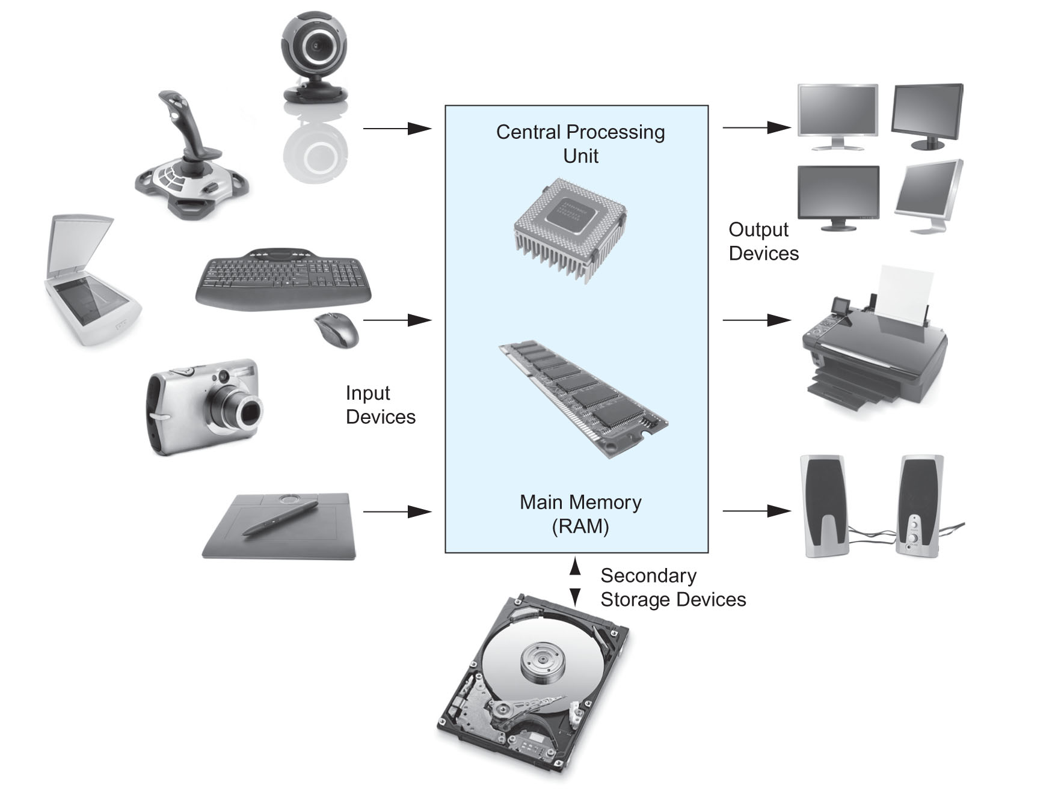
Main Hardware Component Categories
1-<number>

Slide 7
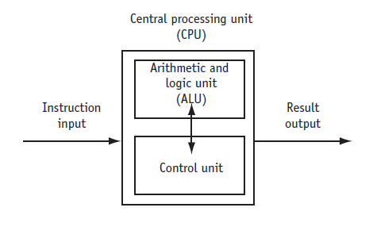
Central Processing Unit (CPU)
CPU – Hardware component that runs programs
Includes
Control Unit
  Retrieves and decodes program instructions
  Coordinates computer operations
Arithmetic & Logic Unit (ALU)
  Performs mathematical operations
1-<number>

Slide 8
The CPU's Role in Running a Program
Cycle through:
Fetch: get the next program instruction from main memory
Decode: interpret the instruction and generate a signal
Execute: route the signal to the appropriate component to perform an operation
1-<number>

Slide 9
Main Memory
Holds both program instructions and data
Volatile – erased when the program terminates or computer is turned off
Also called Random Access Memory (RAM), because the CPU can access data and instructions from any memory location.
1-<number>

Slide 10
Main Memory Organization
Bit
  Smallest piece of memory
  Stands for binary digit
  Hold an electrical charge
    A positive charge is “on”
    A negative charge is “off”
Byte
  Is 8 consecutive bits
  Has an address in memory
  There are millions (or even billions) of bytes of memory in a computer
1-<number>

Slide 11
Secondary Storage
Holds data when the program is not running or when the computer is turned off
Several forms of secondary storage
  disk drive: can be mounted inside the computer or connected to an external port. Data is stored magnetically
  optical: CD or DVD drive
  flash: USB flash drive
1-<number>

Slide 12

Input Devices
Used to send information to the computer from outside
Many devices can provide input
  keyboard, mouse, touch screen, microphone, scanner, digital camera, disk drive, CD/DVD drive, USB flash drive
1-<number>

Slide 13


Output Devices
Used to send information from the computer to the outside
Many devices can be used for output
  Computer screen, printer, speakers, disk drive, CD/DVD recorder, USB flash drive
1-<number>

Slide 14
Software Programs That Run on a Computer
System software
  programs that manage the computer hardware and the programs that run on the computer
  Operating Systems
    Controls the operation of the computer
    Manages connected devices and access to storage devices
    Allows programs to run
  Utility Programs
    Support programs that enhance computer operations
    Examples: virus scanners, data backup, file compression
  Software development tools
    Used by programmers to create software
    Examples: compilers, integrated development environments (IDEs)
1-<number>

Slide 15
1.3 Programs and Programming Languages
Program
a set of instructions directing a computer to perform a task
Programming Language
a special language used to write programs
1-<number>

Slide 16
Algorithm
Algorithm: a set of well-defined steps to perform a task or to solve a problem
Order is important. Steps must be performed sequentially
1-<number>

Slide 17
Programs and Programming Languages
Types of languages
  Low-level: used for communication with computer hardware directly. Not very easy for a person to read.
  High-level: closer to human language
1-<number>

Slide 18
From a High-level Program to an Executable File
Create a file containing the program with a text editor.
  program statements: source code
  file: source file
Run the preprocessor to convert source file directives to source code program statements.
Run the compiler to convert source program statements into machine instructions (machine code), which is stored in an object file.
1-<number>

Slide 19
From a High-level Program to an Executable File
Run the linker to connect hardware-specific library code to machine instructions, producing an executable file.
Steps b) through d) are often performed by a single command or button click.
Errors that occur at any step will prevent the execution of the following steps.
1-<number>

Slide 20
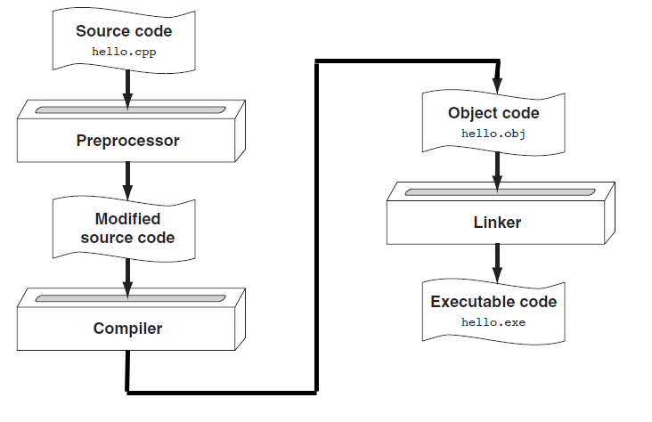
From a High-level Program to an Executable File
1-<number>

Slide 21
Putting It All Together
There are many software development systems that provide an integrated development environment (IDE). An IDE has the following:
  text editor
  compiler
  debugger
  other supporting utilities
  a user interface that ties them all together
1-<number>
Notes:
See pr1-01.cpp

Slide 22
1.4 What Is a Program Made Of?
There are common elements in most programming languages
1) Language elements:
  Key Words
  Programmer-Defined Identifiers
  Operators
  Punctuation
  Syntax
1-<number>
Notes:
See pr1-01.cpp

Slide 23
Example Program
#include <iostream>
using namespace std;
int main()
{
double num1 = 5,
num2, sum;
num2 = 12;
sum = num1 + num2;
cout << "The sum is " << sum;
return 0;
}
1-<number>

Slide 24
Key Words
Also known as reserved words
Have a special meaning in C++
Can not be used for another purpose
Written using lowercase letters
Examples in program (shown in green):
using namespace std;
int main()
1-<number>

Slide 25
Programmer-Defined Identifiers
Names made up by the programmer
Not part of the C++ language
Used to represent various things, such as variables (memory locations)
Example in program (shown in green):
double num1
1-<number>

Slide 26
Operators
Used to perform operations on data
Many types of operators
  Arithmetic: +, -, *, /
  Assignment: =
Examples in program (shown in green):
num2 = 12;
sum = num1 + num2;
1-<number>

Slide 27
Punctuation
Characters that mark the end of a statement, or that separate items in a list
Example in program (shown in green):
double num1 = 5,
num2, sum;
num2 = 12;
1-<number>

Slide 28
Lines vs. Statements
In a source file,
  A line is all of the characters entered before a carriage return.
  Blank lines improve the readability of a program.
  Here are four sample lines. Line 3 is blank:
  1. double num1 = 5, num2, sum;
  2. num2 = 12;
  3.
  4. sum = num1 + num2;
1-<number>

Slide 29
Lines vs. Statements
In a source file,
  A statement is an instruction to the computer to perform an action.
  A statement may contain keywords, operators, programmer-defined identifiers, and punctuation.
  A statement may fit on one line, or it may occupy multiple lines.
  Here is a single statement that uses two lines:
  double num1 = 5,
  num2, sum;
1-<number>

Slide 30
Variables
A variable is a named location in computer memory.
It holds a piece of data. The data that it holds may change while the program is running.
The name of the variable should reflect its purpose
A variable must be defined before it can be used. Variable definitions indicate the variable name and the type of data that it can hold.
Example variable definition:
  double num1;
1-<number>

Slide 31
1.5 Input, Processing, and Output
Three steps that many programs perform
  Gather input data
    from keyboard or mouse
    from files on disk drives
  Process the input data
  Output the results of the processing
    send it to the screen or a printer
    write it to a file
1-<number>

Slide 32
1.6 The Programming Process
Define what the program is to do.
Visualize the program running on the computer.
Use design tools to create a model of the program.
    Hierarchy charts, flowcharts, pseudocode, etc.
Check the model for logical errors.
Write the program source code.
Compile the source code.
1-<number>

Slide 33
The Programming Process (cont.)
7. Correct any errors found during compilation.
8. Link the program to create an executable file.
9. Run the program using test data for input.
10. Correct any errors found while running the program.
Repeat steps 4 - 10 as many times as necessary.
11. Validate the results of the program.
  Does the program do what was defined in step 1?
1-<number>

Slide 34
Chapter 1: Introduction to Computers and Programming
Starting Out with C++
Early Objects
Ninth Edition
by Tony Gaddis, Judy Walters,
and Godfrey Muganda

